Slide 1

It’s a Goal
It’s a Goal
By: Jenna Phillips

Slide 2
It’s a Goal
By Your fellow student Jenna

Slide 3


What My Book is About
My book is about how people play soccer, how you can earn trophies, medals, ect. It also tells you how soccer is played all over the world. It is played in places like Turkey, Canada, Mexico and of course USA.

Slide 4
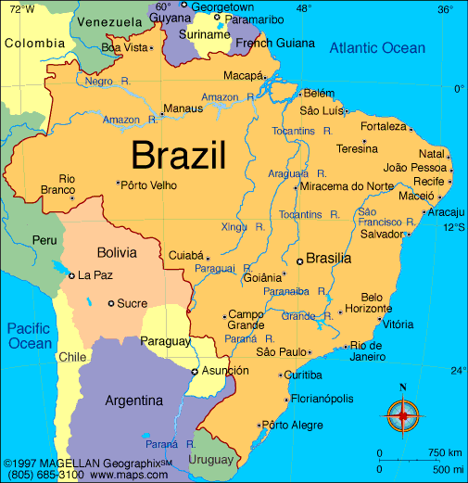
Facts 1 and 2
Did you know that most of the best soccer players come from brazil? Well its true. It is the most popular sport in Brazil. Soccer is called “futebol” in Brazil. It sounds like football in American.
Did you know that soccer was introduced by Charles Miller when he came home from school in England.

Slide 5


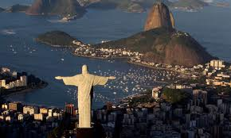
Facts 3 and 4
Did you know that the worlds largest stadium is located in Rio de Janeiro?
Did you know that the record for the biggest soccer crowd was in Glasgow, Scotland in 1937? The number of the crowed was 149,547. That’s a big number

Slide 6

Facts 5 and 6
Did you know that the length of a minimum soccer field is 110 yards the maximum is 120? The width is 80 yards. The field size for women and juniors are smaller.
Did you know that there is a sport called wheelchair soccer? When you play wheelchair soccer you play with a bigger ball and it was made for people that are disabled.

Slide 7

Facts 7 and 8
Did you know that the World Cup is the most important competition in soccer. The World Cup has been held every 4 years since 1930?
Did you know that the women's World Cup has been held since 1991?

Slide 8
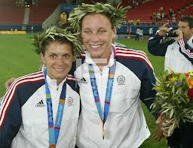
Facts 9 and 10
Did you know that only 13 teams played in the first World Cup in 1930? Well that is totally true. In 1934-1978 there were 16 teams that would play for the award. From 1998 and so on there has been 32 teams playing.
Did you know that Mia Hamm is know as the best women’s soccer player in the world? Did you also know that Mia is Abby Wambach’s mentor?

Slide 9
Facts 11 and 12
Did you know that kids all over the world play soccer? Well it is true. You don’t have to be rich to play. Anyone can play a fun game like soccer.
Did you know that the most extreme wealthy soccer clubs come from England and other places in Europe? People that sign up for these leagues pay a large fee.

Slide 10
Facts 13, 14 and 15
Did you know they are trying to recruit a NINE year old boy to Brazil because he was such a good soccer player. His name is Jean Carlos Chera.
Pele is consider to be the greatest male Brazil soccer player of all time. He scored 1,281 goals in 1,363 games.
Brazil’s Ronaldo is one of the most expensive soccer players ever.

Slide 11


Hope You Enjoyed

Slide 12
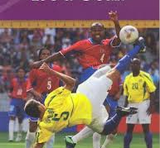
it’s a Goal
My book Is a great book I asked a few people about this book and they said that it was a very good book. If I could rate the book I would give it 4 stars. My mom would give it 3 I would give it 4 because It has good detail but it is not just about soccer. My mom gives it three stars because she thinks it needs more material.
My score
My Moms score

