Slide 1
Autism
By: Jenna Phillips

Slide 2
What is Autism
Autism is a brain disorder that often lower the ability to speak and different areas of the brain do not work together. Some parts of the brain effected by autism is the Agmudala and the hippocampus.

Slide 3
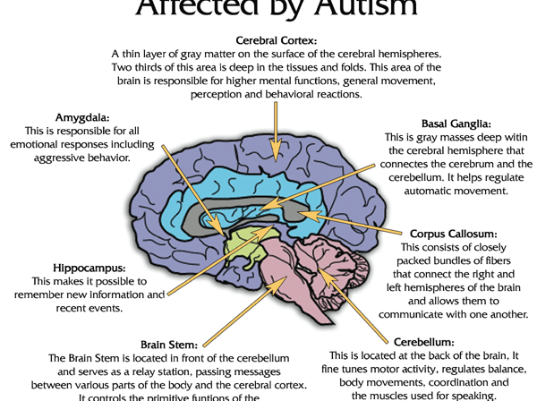
Parts of the brain effected by autism.

Slide 4
How autism is caused
Most people think that autism runs through the family and you inherit it. Scientists are trying to find out what causes autism and how it runs through the family.

