Slide 1
Mocking Bird
By: Jenna Phillips

Slide 2
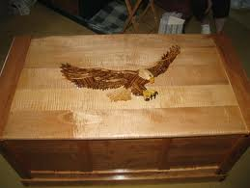
What Happened In The Beginning
A girl named Cathlin was staring at her older brother, Devon's , unfinished Eagle Scout chest which was covered up by a grey sheet. It could not be finished by Devon because he died.
There was a shooting at Devon's middle school and Devon was one of the people to get shot. Most people from his town were deeply upset by the shooting.
The town knew that Cathlin was upset and they wanted to help her Cathlin did not want help from a bunch of strangers. Cathlin’s dad kept telling her it would be good for her but Cathlin did not listen and felt there was too much pressure on her. She wanted to hide in Devon’s room, but she is not allowed in there.
This is a eagle scout chest just like Devon's

Slide 3
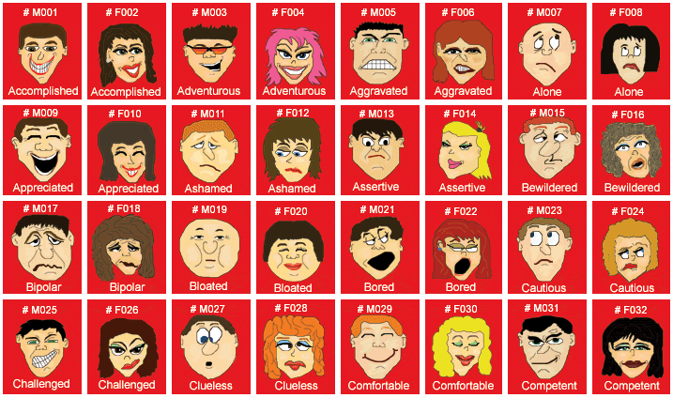
What Went on in the Middle
A boy named Josh was saying mean things to Cathlin such as “ Ohh I tried to save Poor old Devon when he was in the hospital”. He also said, “ His heart was hanging out from the chest and they could not close it up boo hoo.” Cathlin started to cry, but a nice girl named Emma told Josh to stop and leave her alone.
Cathlin went to her counselor Mrs. Brooks to talk. There was a facial expressions chart to help her figure out what emotions go with each face. Mrs. Brooks told Cathlin that she needs to use these charts to help her understand other people and how she feels. Mrs. Brooks said that it is harder for her to understand others because she has Asperger’s and the chart may help her.

Slide 4
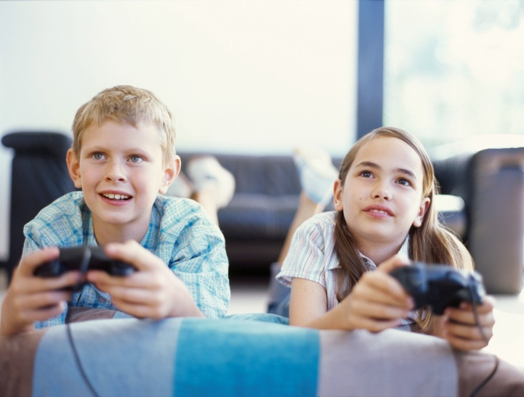
What goes on at the End
Cathlin decided that it was time to finish Devon's Eagle Scout chest. She asked her dad if they could work on it together and he said …. YES. Cathlin was so happy because she was able to get closure. They worked for day until it was finally finished.
After that, Cathlin and her dad went to the middle school for a memorial service. Josh was there and Cathlin’s friend Michel was there too. As the service went on, the kids went out side and played. Cathlin, Michel and Josh all became friends and played together all the time

Slide 5
My Favorite Part
Cathlin decided to finish up the Eagle Scout chest. It is my favorite part because I am happy that Cathlin was able to finish this for her brother.
I also like that part because I like that Cathlin could finally move on and feel a sense of accomplishment.

Slide 6
My Favorite Characters in the story
Cathlin, Emma and Michel. They all have a different personality and they all are very nice to each other in the story

Slide 7
If I could Rate this Book I Would give it …..
Four and a half Smiles because it is based off of a true story. There was a shooting at Virginia Tech a few years ago. I also give that many stars because it was very detailed and gave you different emotions through out the book.
Yellow= full face
Orange= half face

Slide 8
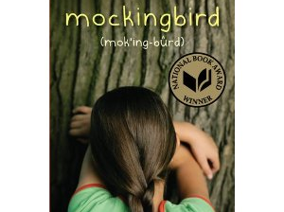
This is My Book Mocking Bird
This is the award the book got
I hope you enjoyed My summary about this Book. It has won a National book a award is now one of My favorite Books Hope you enjoy it as much as I did!

